Slide 1
South County Survey Results
San Luis Obispo County Community College District Board of Trustees Meeting June 7, 2017

Slide 2
Purpose
To assess familiarity and likelihood of enrollment in Cuesta College courses among South County residents
To identify what types of courses and programs South County residents would be interested in taking
To identify where, when, and how South County residents would like to have those courses and programs delivered

Slide 3

Methodology and Sample Frame
Contracted with Hanover Research
Random Phone and Email Survey
Sample Frame:

Slide 4
Responses, Confidence Level, Margin of Error
295 valid responses
95% CI, ± 6 ppts
Example: 30% of sample affirms an item. Given the CI, we can
be 95% confident that the true population value lies within 30% ± 6
or between 24% and 36%. Given the sample frame of roughly 75,000
residents, this means that we can be 95% confident that between
18,000 and 27,000 South County residents would have affirmed this
Item.

Slide 5
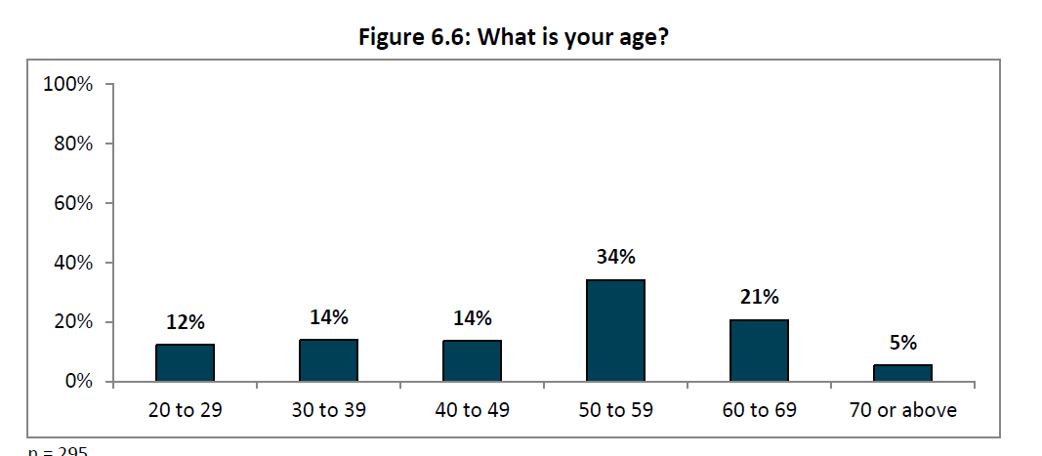
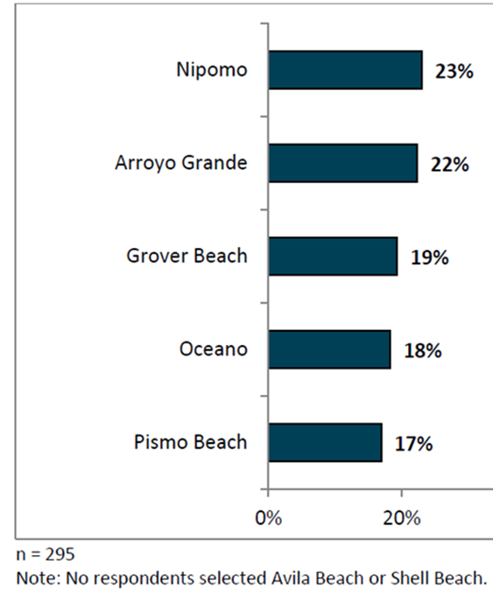
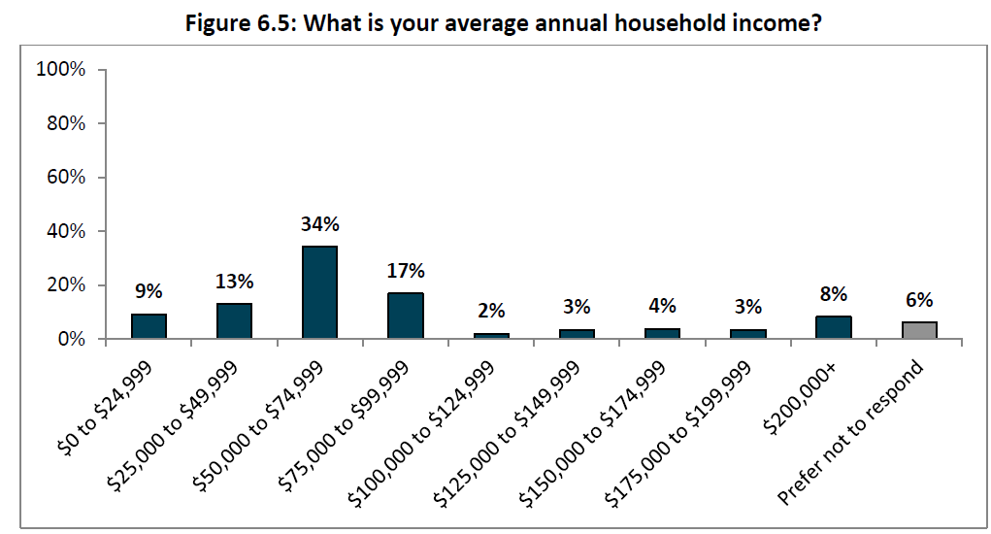
External Validity

Slide 6
SALIENT FINDINGS

Slide 7
Past Enrollment Patterns and Future Likelihoods of Enrollment

Slide 8
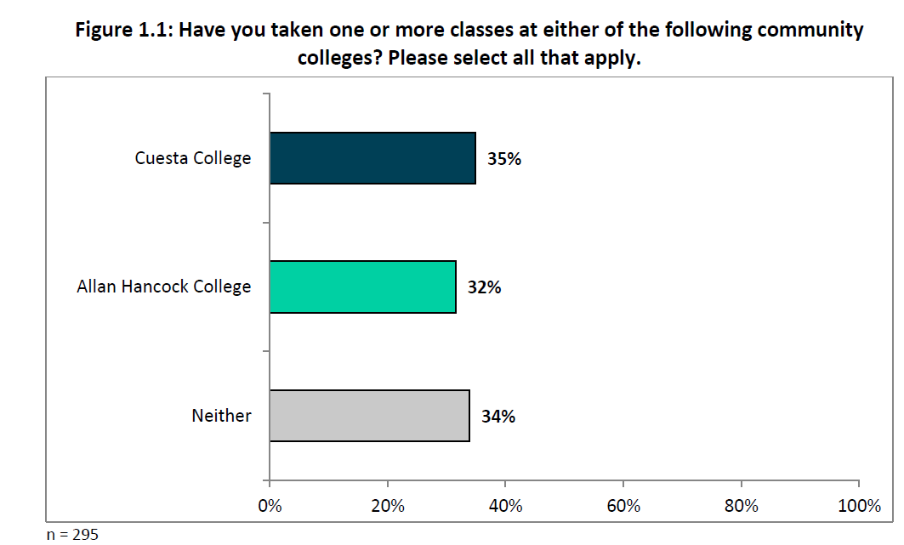
Past Enrollment Patterns

Slide 9
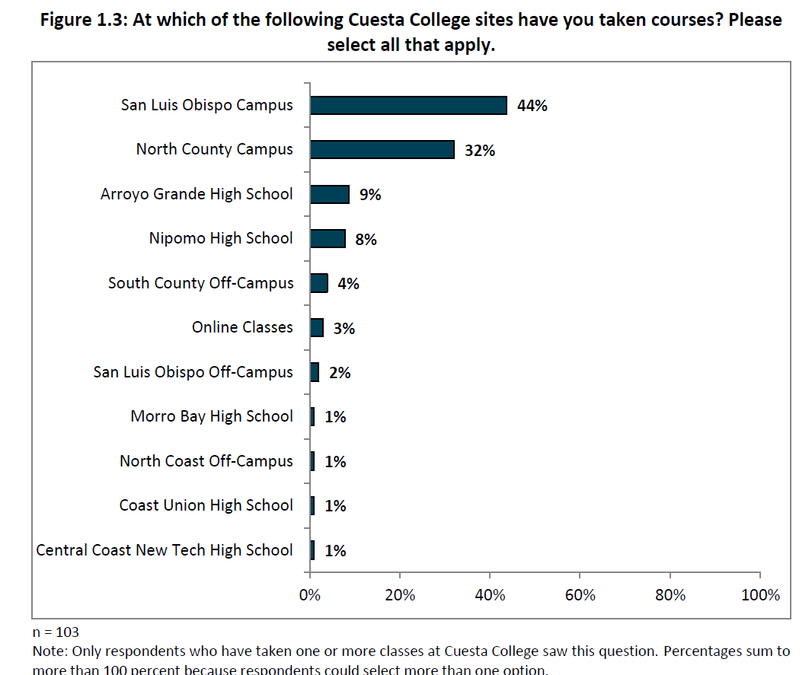
Past Enrollment Locations (Cuesta)

Slide 10
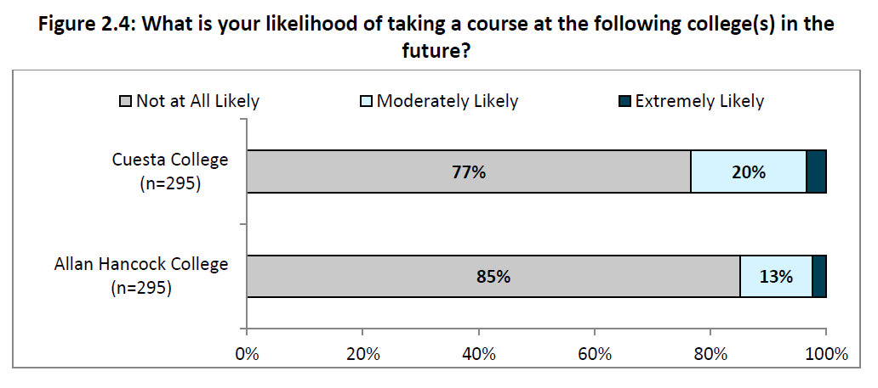
Future Enrollment Likelihood

Slide 11
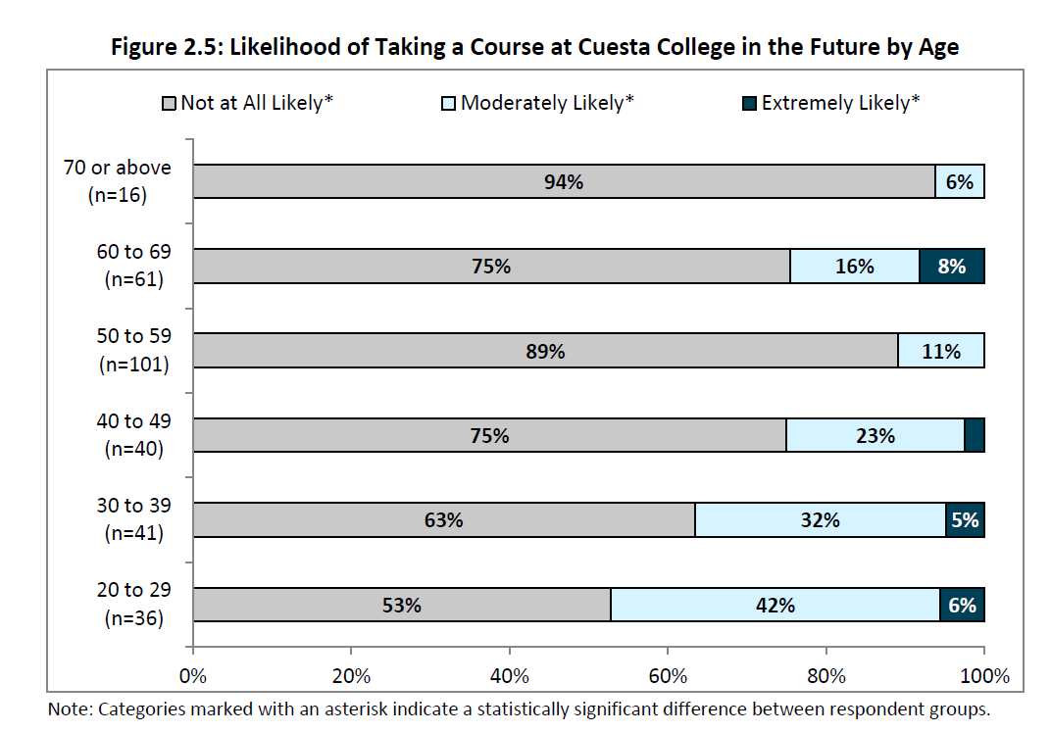
Future Enrollment Likelihood by Age (Cuesta)

Slide 12
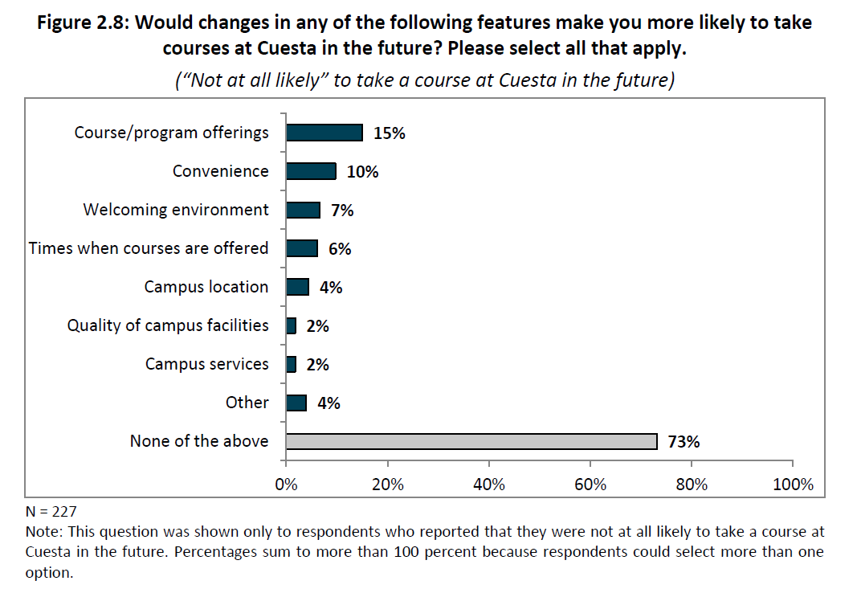
Future Enrollment Likelihood – what would increase likelihood of attending Cuesta?

Slide 13
The Cuesta Promise

Slide 14
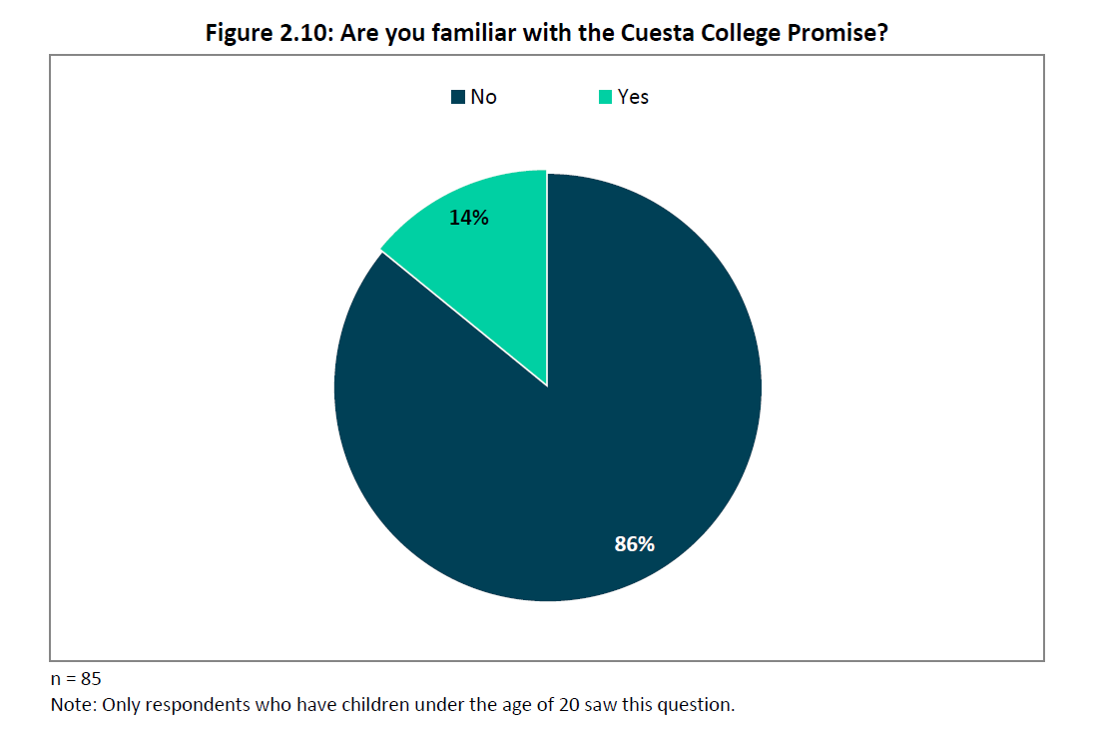
Familiarity with the Cuesta Promise

Slide 15
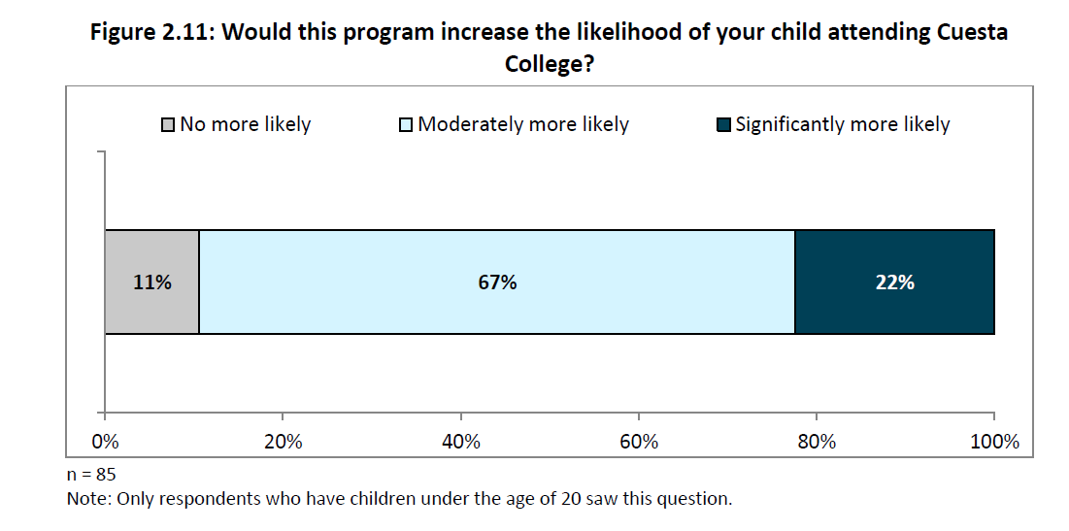
Impact of the Cuesta Promise

Slide 16
Promise Effect – Percent of Headcount Residing in South County

Slide 17
Program Interest

Slide 18
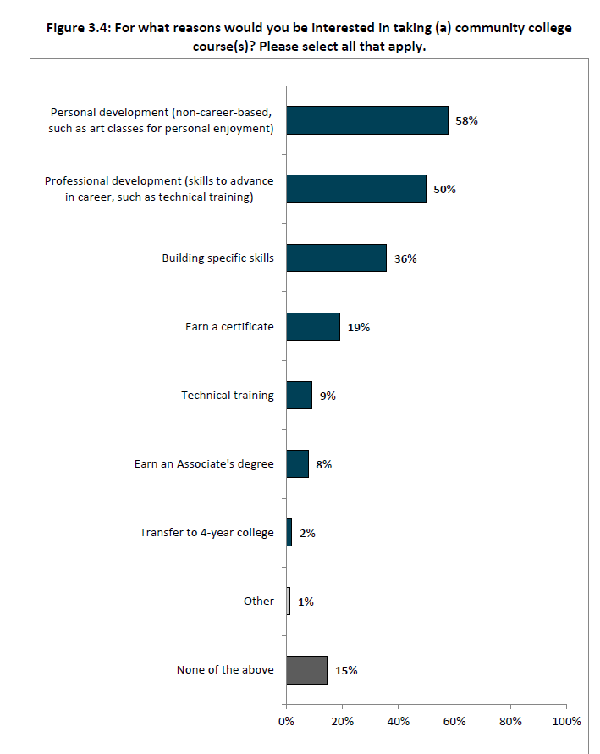
Educational Goals
Personal Development (58%)
Professional Development (50%)
AA/AS/ADT (8%)
Transfer (2%)

Slide 19
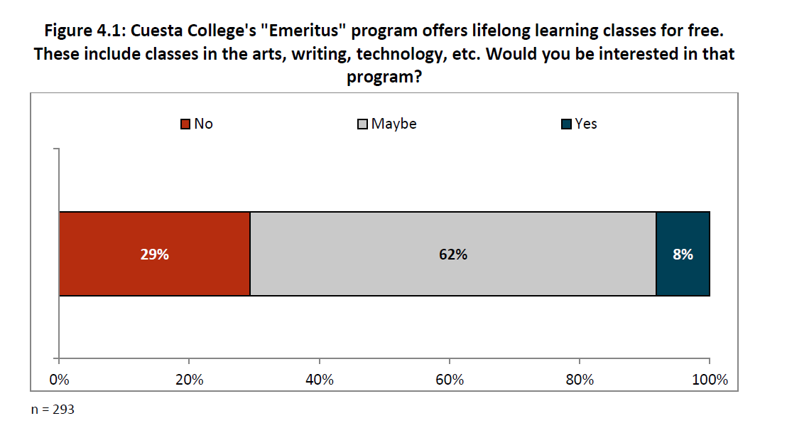
Interest in Emeritus

Slide 20
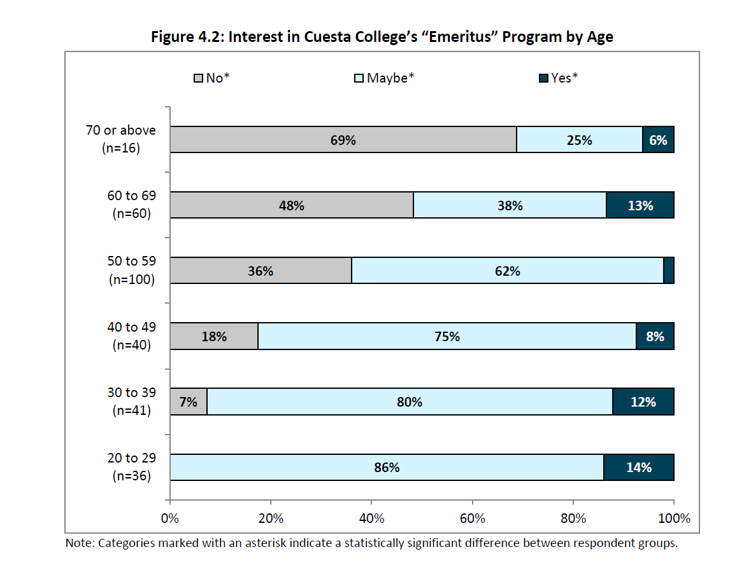
Interest in Emeritus by Age Group
Interest in the Emeritus Program is inversely related to Age

Slide 21
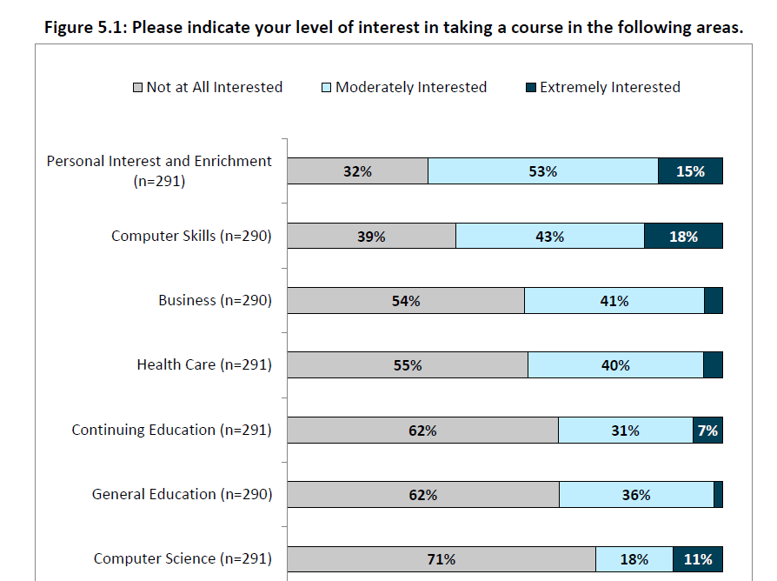
Course-taking interest
Enrichment
Computer Skills
Computer Science

Slide 22
Where, When & How?

Slide 23
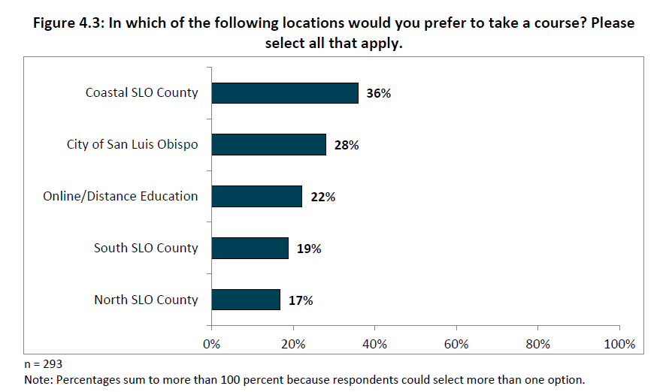
Preferred Location for Courses

Slide 24
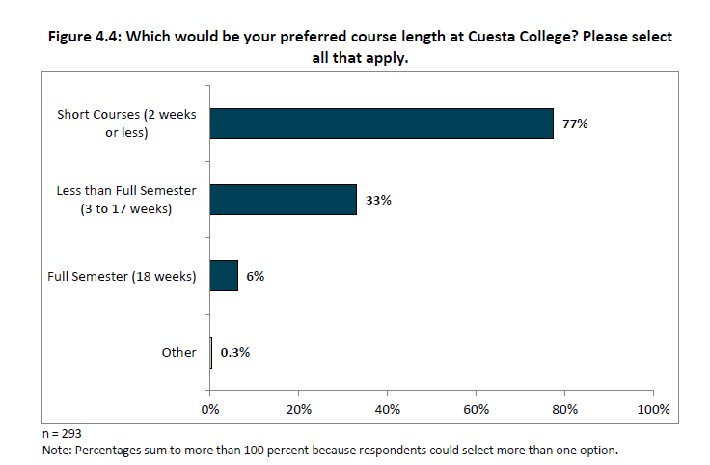
Preferred Course Length

Slide 25
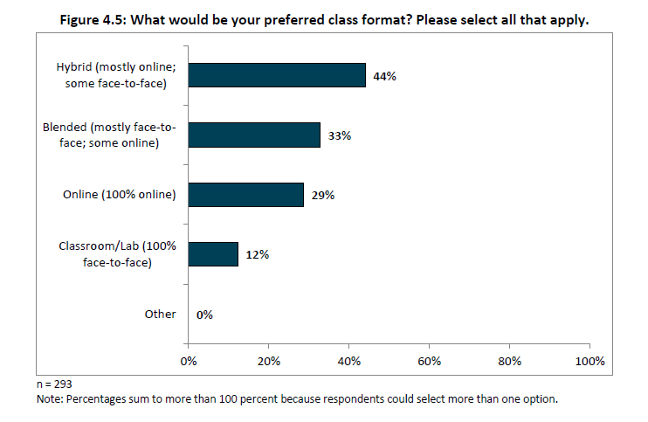
Preferred Course Delivery Modality

Slide 26
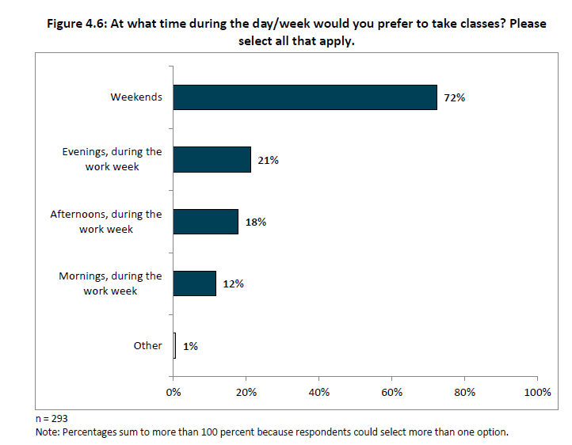
Preferred Course Meeting Days/Times

Slide 27
Questions?

