Slide 1

Healthy Workplace
Healthy Families Act (AB 1522)
Paid Sick Leave
Effective 07/01/15

Slide 2
Covered Employees:
Hourly
Temporary
Student
Those not covered by a collective bargaining agreement which provides for paid sick days that meets or exceeds the requirements of this Act
Paid Sick Leave (AB 1522)

Slide 3
Eligibility
Employed or is anticipated to be employed for at least 30 working days in the fiscal year.
May use accrued time beginning on the 90th day of employment.
Paid Sick Leave (AB 1522)

Slide 4
Accrual
Accrue 1 hour for every 30 hours worked.
Accrual begins on 07/01/15 or the first day of employment, whichever is later.
Maximum accrual shall not exceed six (6) days (48 hours).
Accrued hours carry over to the following year. 48 hour max rule applies to carry over.
Paid Sick Leave (AB 1522)

Slide 5
Usage
Must meet 30 day eligibility.
May begin on 90th day of employment.
May only use number of hours accrued and available at the time.
Usage limit of 24 paid sick hours per fiscal year.
May request in writing or verbally.
If need is foreseeable, employee shall provide reasonable advance notification.
Paid Sick Leave (AB 1522)

Slide 6
Acceptable Use
Employee may use paid sick leave for themselves or an immediate family member for the diagnosis, care or treatment of an existing health condition or preventive care.
An employee who is a victim of domestic violence, sexual assault, or stalking.
Paid Sick Leave (AB 1522)

Slide 7
Employers May Not
Deny an employee the right to use accrued paid sick leave.
Discharge, demote, suspend or discriminate against the employee.
Require employee to find a replacement.
Require employee to provide details for use of paid sick leave.
Paid Sick Leave (AB 1522)

Slide 8
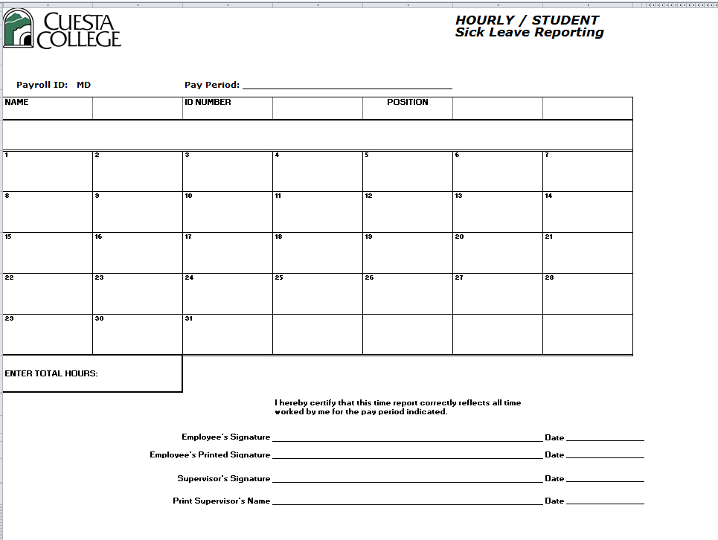
Reporting Sick Time Used
Must fill out paper “Sick Leave Reporting” timesheet.
Requires supervisor signature.
Due and paid in normal payroll cycle.
Form is available in Payroll Forms on My Cuesta or from department.
Paid Sick Leave (AB 1522)

Slide 9
Break in Service
An employee who leaves and returns to active employment within one year shall have his/her previously accrued but unused sick leave balance reinstated.
Employee shall be eligible to accrue additional days upon rehire, in accordance with and subject to all provisions of this Act.
Unused sick days are not paid out upon termination, resignation, retirement or other separation from employment.
Paid Sick Leave (AB 1522)

Slide 10
Protection from Retaliation
Paid Sick Leave law protects employees who
Use Sick Leave.
File a complaint with the Labor Commissioner’s Office.
Allege violation of these rights.
Cooperate in an investigation or prosecution.
Oppose a policy or practice prohibited by this Act.
Paid Sick Leave (AB 1522)

Slide 11

References
AB 1522 – Healthy Workplaces, Healthy Families Act of 2014
AB 304, 7/13/15 Update to AB 1522
Labor Code section 230 (c), 231.1 (a), 2810.5, 245 et seq.
Education Code 88191, 87781

